Slide 1

Toronto Dingos
Awards Night 2013
Saturday, October 26th
Fionn MacCool’s

Slide 2
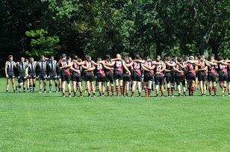
Agenda
Introduction: Presidential Address
Game Milestones
Goalkicking Award
      FIRST COURSE
Vote Count, First 5 Rounds – Div 1 &Div 2
      MAIN COURSE
Clubman Award
Coach’s Award – Div 1 &Div 2
Most Improved Award
Vote Count, Next 4 Rounds
      DESSERT COURSE
Life Membership Award – Yoni Moussadji
Vote Count, Final 3 Rounds
Rookie of the Year
Best &Fairest Awards

Slide 3
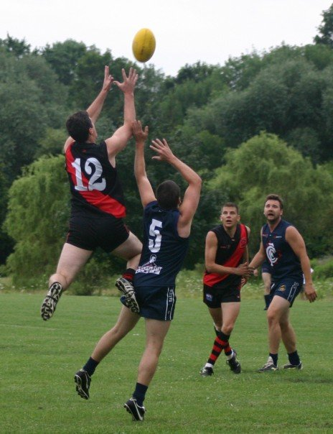
A word from our President...

Slide 4
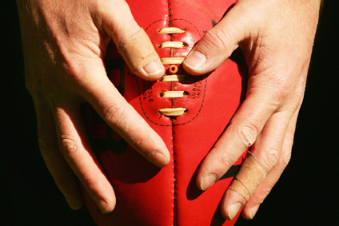
Game Milestones

Slide 5
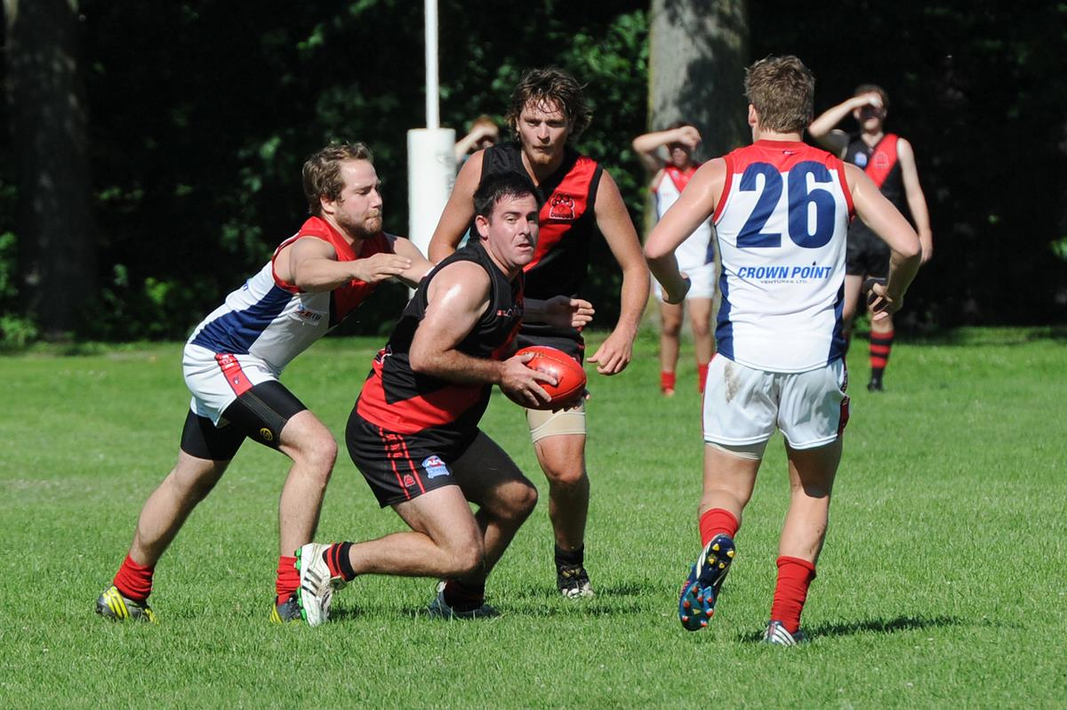
Justin Robertson
50 Games
Congratulations to Justin Robertson for playing 50 games with the Toronto Dingos!
  60 Total Games

Slide 6
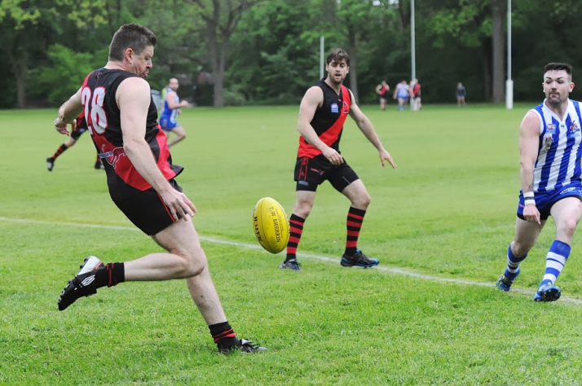
Bobby Clarke
150 Games
Congratulations to Bob Clarke for playing 150 games with the Toronto Dingos!
  157 Total Games

Slide 7
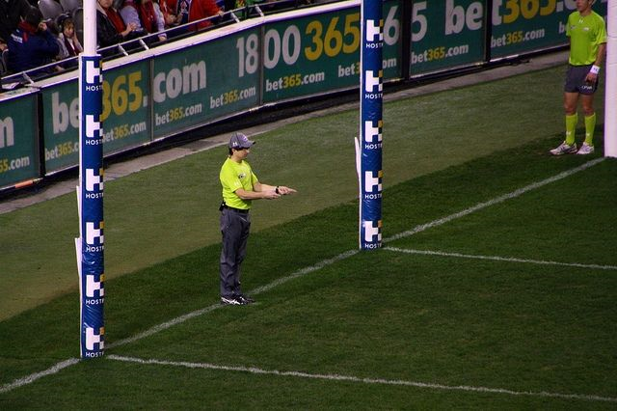
Goalkicking Award

Slide 8
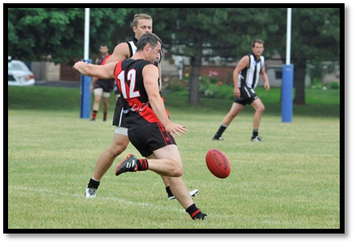
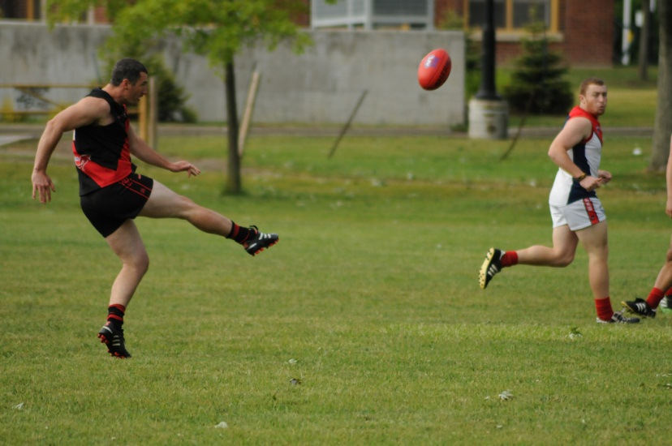
Goalkicking Award 2013
Winner : Wade Edwards
(36 goals in 2013)

Slide 9
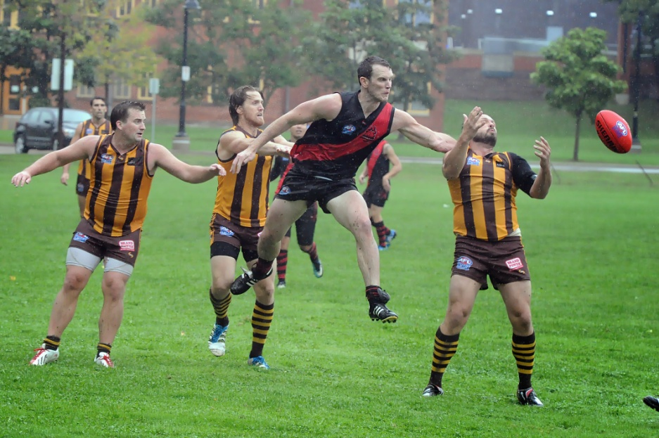
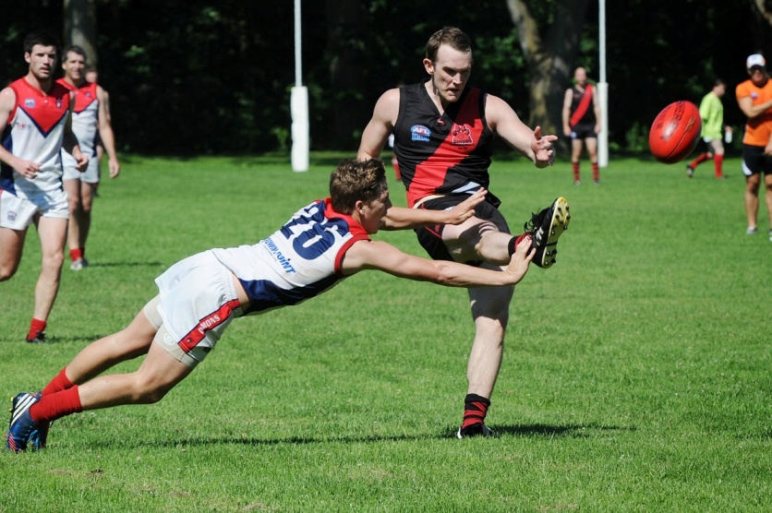
Goalkicking Award 2013
Winner : Wade Edwards
(36 goals in 2013)

Slide 10



FIRST COURSE
MAJOR SPONSOR

Slide 11


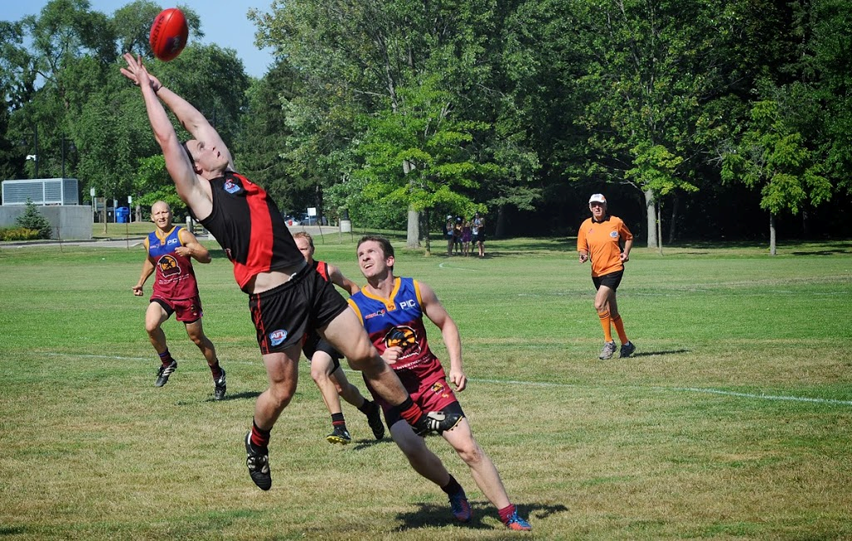
ROUND 1
  Division 1
  7.13-55 4.2-26
  Goals : Wade 3, Denis, Kyle M, Camilo, Max
  Best : Shauny, Jimmy

Slide 12
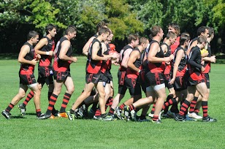
ROUND 1 VOTES
DIVISION 1
Wade Edwards 18 (7,6,5)
Shaun McKay 14 (7,7,0)
D’Arcy Hill 11 (4,4,3)
Jimmy Duggan 6 (0,0,6)
M. MacFarlane 6 (6,0,0)
Craig Stewart 5 (5,0,0)
Pat Bossey 5 (0,5,0)
Max Parish 4 (0,0,4)
Justin Robertson 3 (3,0,0)
David Wells 3 (0,3,0)

Slide 13

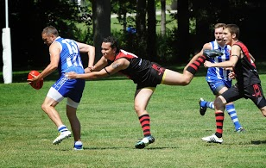
ROUND 2
  Division 1
  8.7-55 8.7-55
  Goals : Wade 4, Jimmy, Stewy, Azza, Camilo
  Best : Stewy

Slide 14

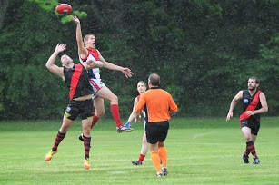
ROUND 2
  Division 2
  5.6-36 3.2-20
  Goals : Gazza 2, Alvin 1, DP, Fitzy 1
  Best : Steve Lanning

Slide 15
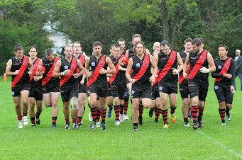
ROUND 2 VOTES
DIVISION 1
Craig Stewart 18 (7,7,4)
Wade Edwards 16 (3,6,7)
Malcolm Brady 16 (6,5,5)
R. Blacklock 10 (4,3,3)
D’Arcy Hill 9 (5,4,0)
Tom Bell 6 (0,0,6)

Slide 16
ROUND 2 VOTES
DIVISION 1
Craig Stewart 18 (7,7,4)
Wade Edwards 16 (3,6,7)
Malcolm Brady 16 (6,5,5)
R. Blacklock 10 (4,3,3)
D’Arcy Hill 9 (5,4,0)
Tom Bell 6 (0,0,6)
DIVISION 2
Steve Lanning 3
Gary Conlon 2
Alvin Ranchhod 1

Slide 17

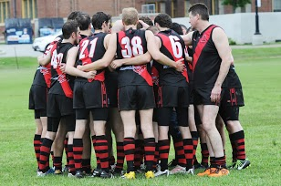
ROUND 3
  Division 1
  9.9-63 4.3-27
  Goals : Stewy 3, Kyle, D’Arcy, Wade, Max
  Best : Kyle, Jimmy

Slide 18
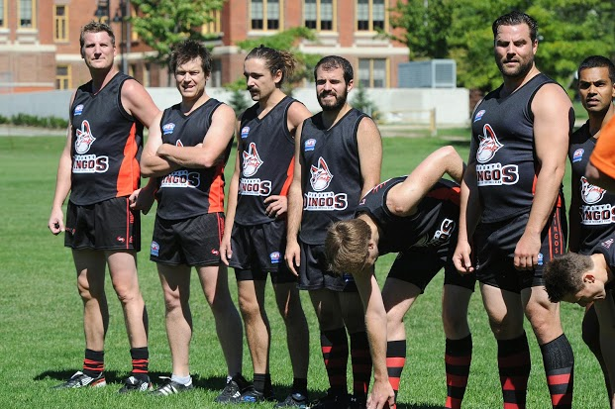
ROUND 3
  Division 2
  9.9-63 4.3-27
  Goals Camilo 3, Ben Kav 2, Mick, Crossy
  Best : Ben Kav

Slide 19
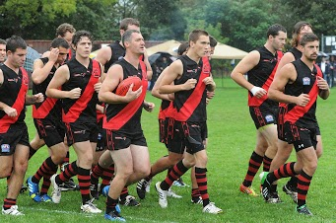
ROUND 3 VOTES
DIVISION 1
James Duggan 21 (7,7,7)
Kyle Morrison 17 (6,6,5)
Malcolm Brady 11 (5,0,6)
Craig Stewart 7 (0,4,3)
R. Blacklock 7 (3,0,4)
A. O’Brien 5 (0,5,0)
Paul Pickering 5 (4,0,0)
Yoni Moussadji 3 (0,3,0)

Slide 20
ROUND 3 VOTES
DIVISION 1
James Duggan 21 (7,7,7)
Kyle Morrison 17 (6,6,5)
Malcolm Brady 11 (5,0,6)
Craig Stewart 7 (0,4,3)
R. Blacklock 7 (3,0,4)
A. O’Brien 5 (0,5,0)
Paul Pickering 5 (4,0,0)
Yoni Moussadji 3 (0,3,0)
DIVISION 2
Ben Kavenagh 3
Drew Bremner 2
Alvin Ranchhod 1

Slide 21

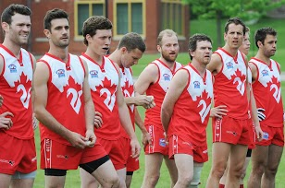
ROUND 4
  Division 1
  10.8-68 8.6-54
  Goals : Stewy 6, Matty, Max, Mal, Danny Mac
  Best : Kristian

Slide 22
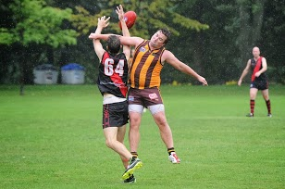
ROUND 4 VOTES
DIVISION 1
Craig Stewart 17 (5,6,6)
Kristian Frantzen 14 (7,7,0)
Jimmy Duggan 13 (6,0,7)
Dave Wells 9 (3,3,3)
D’Arcy Hill 9 (0,5,4)
Camilo Serpa 8 (4,4,0)
Malcolm Brady 5 (0,0,5)

Slide 23

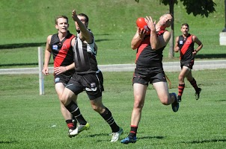
ROUND 5
  Division 1
  8.9-57 11.7-73
  Goals : Mal 3, Tinks, Spider, Denis, Camilo, Max
  Best : OB

Slide 24
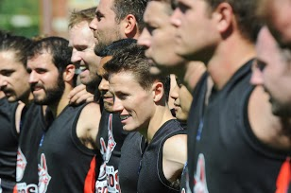
ROUND 5
  Division 2
  8.9-57 11.7-73
  Goals : Tinks 3, JV 3, Alvin, Ben King, Gazza, DP
  Best : Ben King

Slide 25
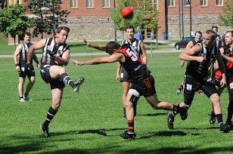
ROUND 5 VOTES
DIVISION 1
Yoni Moussadji 14 (5,3,6)
A. O’Brien 14 (7,7,0)
Craig Stewart 13 (6,7,0)
Tom Bell 12 (3,5,4)
Malcolm Brady 11 (0,6,5)
James Duggan 7 (4,0,3)
Everett Wells 4 (0,4,0)

Slide 26
ROUND 5 VOTES
DIVISION 1
Yoni Moussadji 14 (5,3,6)
A. O’Brien 14 (7,7,0)
Craig Stewart 13 (6,7,0)
Tom Bell 12 (3,5,4)
Malcolm Brady 11 (0,6,5)
James Duggan 7 (4,0,3)
Everett Wells 4 (0,4,0)
DIVISION 2
Ben King 3
JV Arnaldo 2
Steve Gordon 1

Slide 27


Standings after 5 ROUNDs
DIVISION 1
Craig Stewart 60
James Duggan 47
Malcolm Brady 43
Wade Edwards 34
D’Arcy Hill 29
Anthony O’Brien 19
Tom Bell 18
Yoni Moussadji 17
Kyle Morrison 17
R. Blacklock 17
DIVISION 2
Steve Lanning 3
Ben Kavenagh 3
Ben King 3
Gary Conlon 2
Drew Bremner 2
Alvin Ranchhod 2
JV Arnaldo 2
Steve Gordon 1

Slide 28

MAIN COURSE
MAJOR SPONSOR

Slide 29

Clubman Award

Slide 30
Clubman Award steinberg award

Slide 31

Clubman Award - Nominations
Wade Edwards – Coaching Committee, Social Events
James Duggan– Website, GF Party, Social Events
Chris Buczkowski – Manager, Registrar, Asst Coach
Dave Wells– Awards Night, Backround Events, Wells
Justin Robertson – Social Media, Head Coach

Slide 32
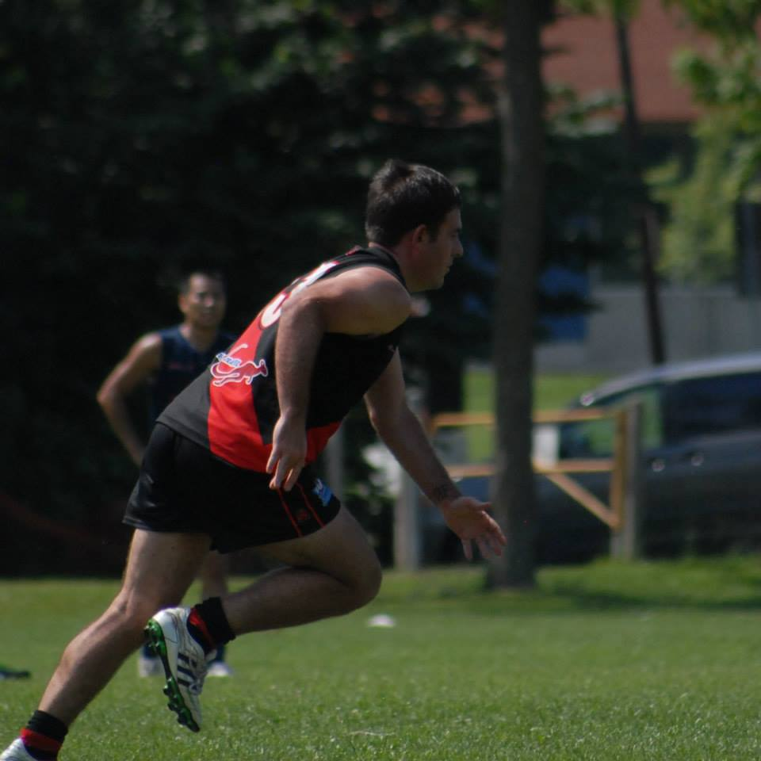
Clubman Award 2012
Winner : Justin Robertson

Slide 33
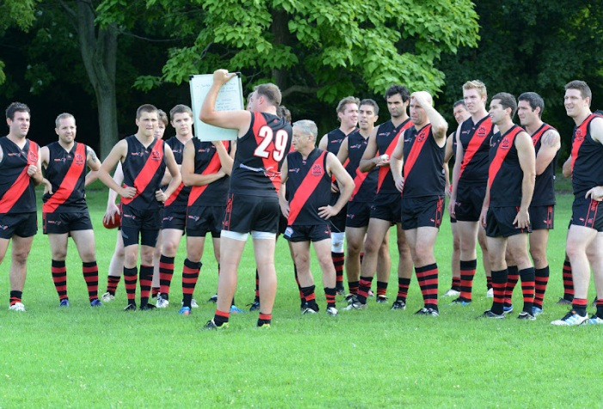
Coach’s Award

Slide 34
Coach’s Award
Previous Winners:
2012 – Pat Bossey (coach: Mick)
2011 – Tom Bell (coach: Butch)
2010 – James Duggan (coach: Mick)
2009 – Tom Bell (coach: Mick)
2008 – Mike Karas (coach: Stewy)
2007 – Mick McFarlane (coach: Brolsy)
2006 – Yoni Moussadji (coach: Committee)
2005 – Mike Karas (coach: Tinks)

Slide 35
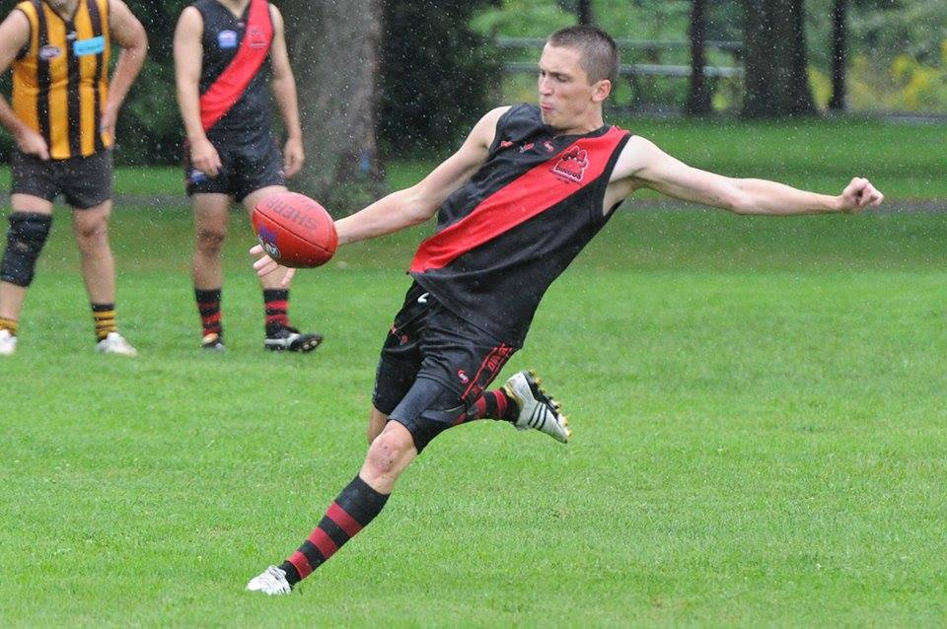
Coach’s Award 2013 division 1
  Winner : James Duggan

Slide 36
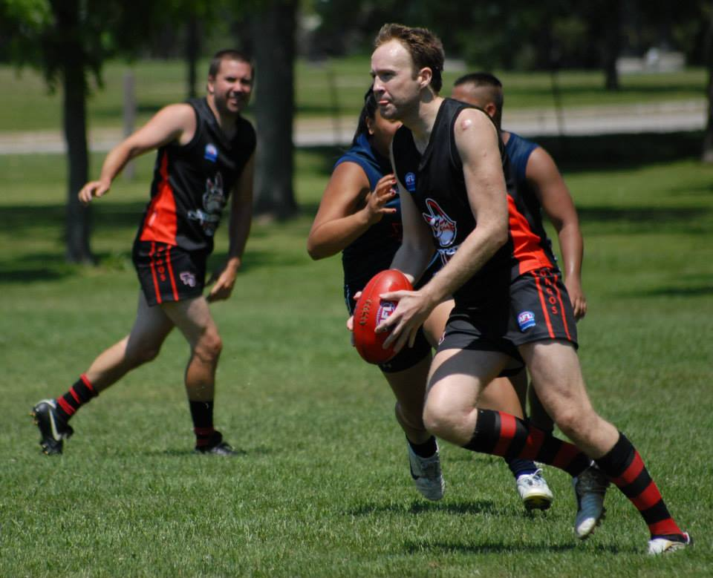
Coach’s Award 2013 division 2
  Winner : Steve Gordon

Slide 37
Most Improved Player Award

Slide 38

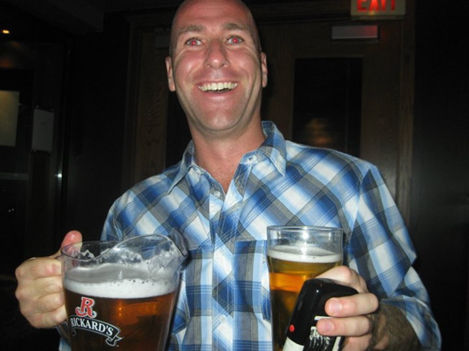
Most Improved Player
Previous Winners:
2012 – Denis Cormier
2011 – Ramsey Blacklock

Slide 39
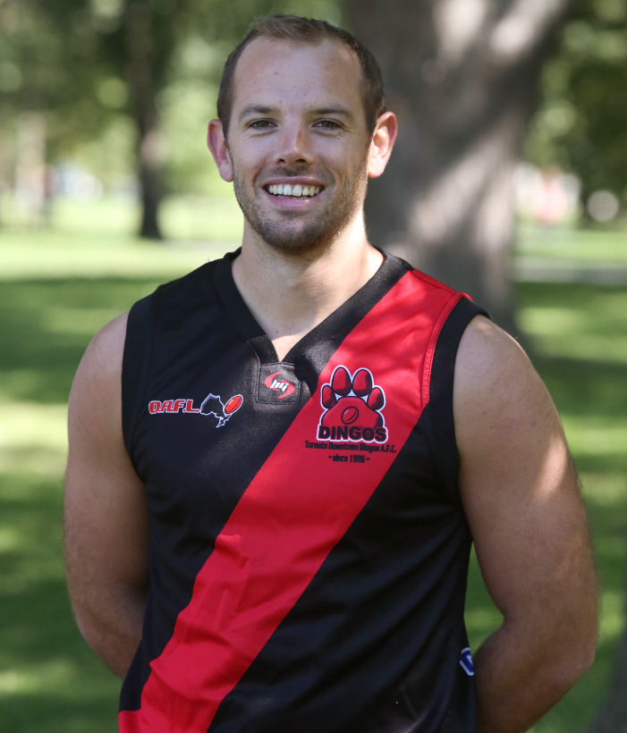
Most Improved Player
  Winner : Max Parish

Slide 40

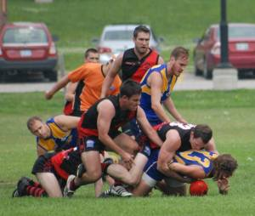
ROUND 6
  Division 1
  7.7-49 8.4-52
  Goals : Wade 5, Butch, Mick
  Best : Wade

Slide 41
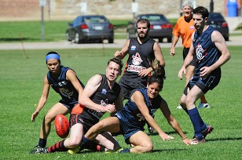
ROUND 6 VOTES
DIVISION 1
Wade Edwards 20 (7,7,6)
M. MacFarlane 16 (5,6,5)
Dave Wells 13 (6,0,7)
James Duggan 9 (3,3,3)
Malcolm Brady 8 (4,4,0)
Yoni Moussadji 5 (0,5,0)
Denis Cormier 4 (0,0,4)

Slide 42
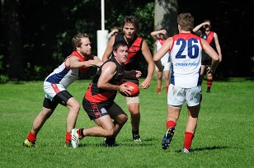
ROUND 7
  Division 1
  9.15-69 5.9-39
  Goals : Wade 3, Mick 2, Butch 2, Shauny, Matty
  Best : Yoni

Slide 43
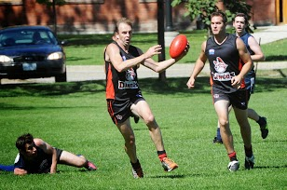
ROUND 7 VOTES
DIVISION 1
Yoni Moussadji 21 (7,7,7)
Dave Wells 12 (6,6,0)
Max Parish 12 (4,4,4)
Wade Edwards 10 (5,0,5)
D’Arcy Hill 8 (3,5,0)
M. MacFarlane 6 (0,0,6)
Shaun McKay 3 (0,0,3)
Camilo Serpa 3 (0,3,0)

Slide 44

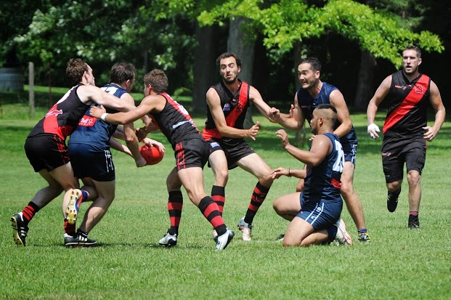
ROUND 8
  Division 1
  9.7-61 1.3-9
  Goals : Stewy 4, Rainer 3, Camilo 2, Butch, OB, Wade
  Best : Max

Slide 45
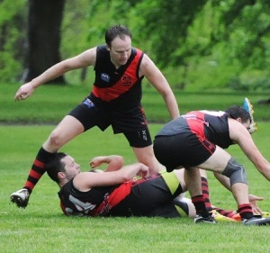
ROUND 8
  Division 2
  9.7-61 1.3-9
  Goals : Tinks 5, Mick 3, Timmy
  Best : Gordo

Slide 46
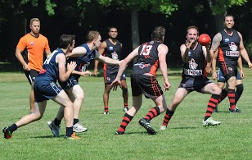
ROUND 8 VOTES
DIVISION 1
Craig Stewart 18 (5,6,7)
Shaun McKay 17 (7,4,6)
Max Parish 17 (6,7,4)
Rainer Haycraft 10 (4,3,3)
Wade Edwards 5 (0,5,0)
A. O’Brien 5 (0,0,5)
Denis Cormier 3 (3,0,0)

Slide 47
ROUND 8 VOTES
DIVISION 1
Craig Stewart 18 (5,6,7)
Shaun McKay 17 (7,4,6)
Max Parish 17 (6,7,4)
Rainer Haycraft 10 (4,3,3)
Wade Edwards 5 (0,5,0)
A. O’Brien 5 (0,0,5)
Denis Cormier 3 (3,0,0)
DIVISION 2
Steve Gordon 3
Dan Prior 2
Steve Lanning 1

Slide 48

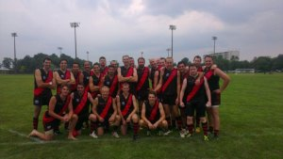
ROUND 9
  Division 1
  16.11-107 5.4-34
  Goals : Wade 7, Rainer 2, Matty 2, Camilo 2, Tinks, Robbo, Tom Bell
  Best : Matty

Slide 49
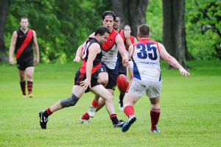
ROUND 9
  Division 2
  4.6-30 3.5-23
  Goals : Tom Evans 2, Tinks, Ben King
  Best : Tom Evans

Slide 50
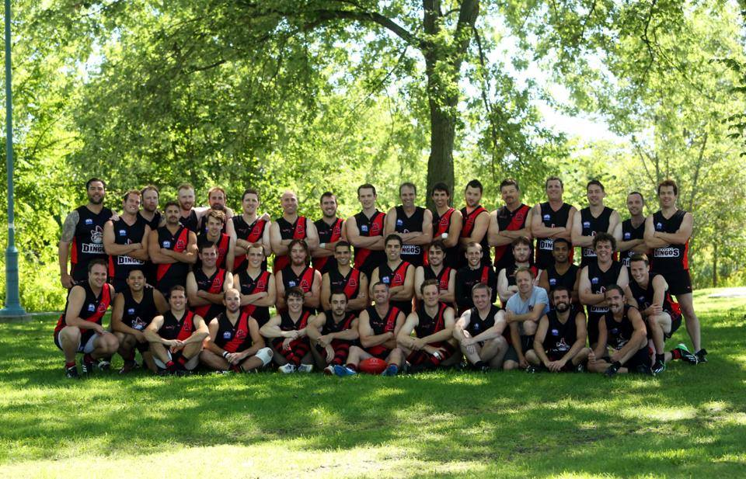
ROUND 9 VOTES
DIVISION 1
Matthew Pollett 21 (7,7,7)
Wade Edwards 13 (6,4,3)
Camilo Serpa 13 (3,6,4)
Rainer Haycraft 11 (5,0,6)
Malcolm Brady 5 (0,0,5)
Paul Pickering 5 (0,5,0)
Tom Bell 4 (4,0,0)
D’Arcy Hill 3 (0,3,0)

Slide 51
ROUND 9 VOTES
DIVISION 1
Matthew Pollett 21 (7,7,7)
Wade Edwards 13 (6,4,3)
Camilo Serpa 13 (3,6,4)
Rainer Haycraft 11 (5,0,6)
Malcolm Brady 5 (0,0,5)
Paul Pickering 5 (0,5,0)
Tom Bell 4 (4,0,0)
D’Arcy Hill 3 (0,3,0)
DIVISION 2
Tom Evans 3
Steve Lanning 2
Joe Carrig 1

Slide 52
Standings after 9 ROUNDs
DIVISION 1
Wade Edwards 82
Craig Stewart 78
James Duggan 56
Malcolm Brady 56
Yoni Moussadji 43
D’Arcy Hill 40
Dave Wells 37
Shaun McKay 34
Max Parish 33
Mick MacFarlane 28
DIVISION 2
Steve Lanning 6
Steve Gordon 4
Tom Evans 3
Ben Kavenagh 3
Ben King 3
Gary Conlon 2
Drew Bremner 2
Alvin Ranchhod 2

Slide 53


DESSERT COURSE
MAJOR SPONSOR

Slide 54
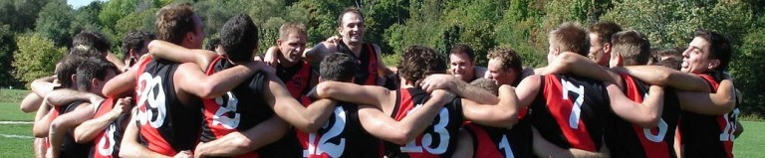
LIFE MEMBERSHIP

Slide 55
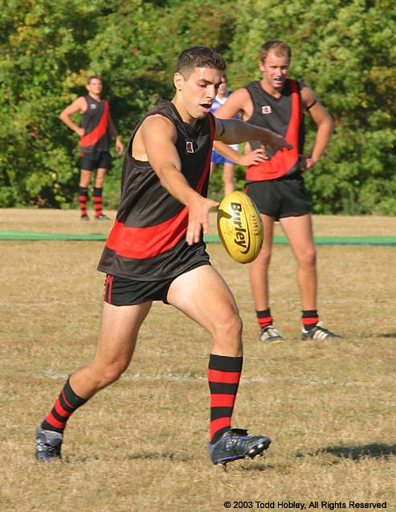
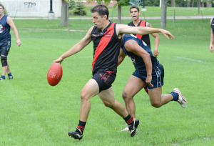
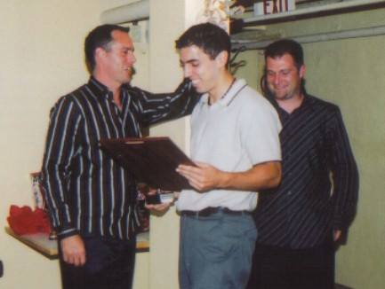
LIFE MEMBERSHIP
YONI MOUSSADJI
2006 Canadian B&f winner
2-time runner-up (2005, 2009)
2 coaches award s (2003, 2006)
96 games played serving 6th year as treasurer
(longest running)

Slide 56
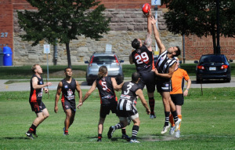
ROUND 10
  Division 2
  8.5-53 5.8-38
  Goals : Ben Kav 4, Mick, Tom Evans, Alvin, Tinks
  Best : Ben Kav

Slide 57
Round 10 Votes
~Division 2~
•BALLOT•
•RUNNING TOTAL•
Best & Fairest
Steve Lanning 6
Steve Gordon 4
Tom Evans 3
Ben Kavenagh 3
Ben King 3
Gary Conlon 2
Drew Bremner 2
Alvin Ranchhod 2

Slide 58
Round 10 Votes
~Division 2~
•BALLOT•
•RUNNING TOTAL•
Steve Gordon 3
Alvin Ranchhod 2
Roman Belli 1
Best & Fairest
Steve Gordon 7
Steve Lanning 6
Alvin Ranchhod 4
Tom Evans 3
Ben Kavenagh 3
Ben King 3
Gary Conlon 2
Drew Bremner 2

Slide 59
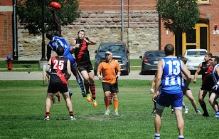
ROUND 10
  Division 1
  15.16-106 2.4-29
  Goals : Wade 5, Butch 3, Mick, Max, Camilo, Jimmy, Tom Evans, Matty, Rainer
  Best : Shauny

Slide 60
Round 10 Votes
•BALLOTS•
•RUNNING TOTAL•
Best & Fairest
Wade Edwards 82
Craig Stewart 78
Malcolm Brady 56
Shaun McKay 34
Mick MacFarlane 28
Best & Fairest
James Duggan 56
Yoni Moussadji 43
D’Arcy Hill 40
Dave Wells 37
Rookie of the Year
D’Arcy Hill 40
Max Parish 33
Camilo Serpa 24

Slide 61
Round 10 Votes
•BALLOTS•
•RUNNING TOTAL•
Shaun McKay 7
Mick MacFarlane 6
Rainer Haycraft 5
Yoni Moussadji 4
Ramsey Blacklock 3
Best & Fairest
Wade Edwards 82
Craig Stewart 78
Malcolm Brady 56
Shaun McKay 41
Mick MacFarlane 34
Best & Fairest
James Duggan 56
Yoni Moussadji 47
D’Arcy Hill 40
Dave Wells 37
Rookie of the Year
D’Arcy Hill 40
Max Parish 33
Camilo Serpa 24

Slide 62
Round 10 Votes
•BALLOTS•
•RUNNING TOTAL•
Shaun McKay 7
Mick MacFarlane 6
Rainer Haycraft 5
Yoni Moussadji 4
Ramsey Blacklock 3
Shaun McKay 7
Rainer Haycraft 6
Yoni Moussadji 5
Wade Edwards 4
Pat Bossey 3
Best & Fairest
Wade Edwards 86
Craig Stewart 78
Malcolm Brady 56
Shaun McKay 48
Mick MacFarlane 34
Best & Fairest
James Duggan 56
Yoni Moussadji 52
D’Arcy Hill 40
Dave Wells 37
Rookie of the Year
D’Arcy Hill 40
Max Parish 33
Camilo Serpa 24

Slide 63
Round 10 Votes
•BALLOTS•
•RUNNING TOTAL•
Shaun McKay 7
Mick MacFarlane 6
Rainer Haycraft 5
Yoni Moussadji 4
Ramsey Blacklock 3
Shaun McKay 7
Rainer Haycraft 6
Yoni Moussadji 5
Wade Edwards 4
Patrick Bossey 3
Shaun McKay 7
Patrick Bossey 6
Rainer Haycraft 5
Tom Evans 4
Chris Buczkowski 3
Best & Fairest
Wade Edwards 86
Craig Stewart 78
Malcolm Brady 56
Shaun McKay 55
Rainer Haycraft 37
Best & Fairest
James Duggan 56
Yoni Moussadji 52
D’Arcy Hill 40
Dave Wells 37
Rookie of the Year
D’Arcy Hill 40
Max Parish 33
Camilo Serpa 24

Slide 64
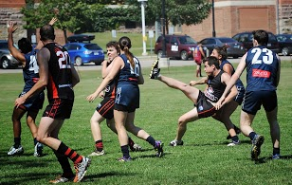
ROUND 11
  Division 2
  17.9-111 3.3-21
  Goals : Ben Kav 8, Tinks 7, JV 2
  Best : Big Jim

Slide 65
Round 11 Votes
~Division 2~
•BALLOT•
•RUNNING TOTAL•
Best & Fairest
Steve Gordon 7
Steve Lanning 6
Alvin Ranchhod 4
Tom Evans 3
Ben Kavenagh 3
Ben King 3
Gary Conlon 2
Drew Bremner 2

Slide 66
Round 11 Votes
~Division 2~
•BALLOT•
•RUNNING TOTAL•
Alvin Ranchhod 3
James Sheehan 2
Robert Fitzhugh 1
Best & Fairest
Steve Gordon 7
Alvin Ranchhod 7
Steve Lanning 6
Tom Evans 3
Ben Kavenagh 3
Ben King 3
Gary Conlon 2
Drew Bremner 2

Slide 67
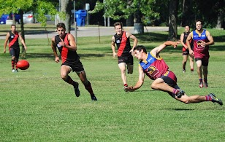
ROUND 11
  Division 1
  14.9-93 4.5-29
  Goals : Wade 5, Camilo 3, Rainer 2, Denis, JV, Tom Evans, Jimmy
  Best : Tom Evans, Spider

Slide 68
Round 11 Votes
•BALLOTS•
•RUNNING TOTAL•
Best & Fairest
Wade Edwards 86
Craig Stewart 78
Malcolm Brady 56
Shaun McKay 55
Rainer Haycraft 37
Best & Fairest
James Duggan 56
Yoni Moussadji 52
D’Arcy Hill 40
Dave Wells 37
Rookie of the Year
D’Arcy Hill 40
Max Parish 33
Camilo Serpa 24

Slide 69
Round 11 Votes
•BALLOTS•
•RUNNING TOTAL•
Tom Evans 7
Everett Wells 6
Wade Edwards 5
James Duggan 4
Rainer Haycraft 3
Best & Fairest
Wade Edwards 91
Craig Stewart 78
Malcolm Brady 56
Shaun McKay 55
Rainer Haycraft 40
Best & Fairest
James Duggan 60
Yoni Moussadji 52
D’Arcy Hill 40
Dave Wells 37
Rookie of the Year
D’Arcy Hill 40
Max Parish 33
Camilo Serpa 24

Slide 70
Round 11 Votes
•BALLOTS•
•RUNNING TOTAL•
Tom Evans 7
Everett Wells 6
Wade Edwards 5
James Duggan 4
Rainer Haycraft 3
Everett Wells 7
Tom Evans 6
Wade Edwards 5
James Duggan 4
Rainer Haycraft 3
Best & Fairest
Wade Edwards 96
Craig Stewart 78
Malcolm Brady 56
Shaun McKay 55
Rainer Haycraft 43
Best & Fairest
James Duggan 64
Yoni Moussadji 52
D’Arcy Hill 40
Dave Wells 37
Rookie of the Year
D’Arcy Hill 40
Max Parish 33
Camilo Serpa 24

Slide 71
Round 11 Votes
•BALLOTS•
•RUNNING TOTAL•
Tom Evans 7
Everett Wells 6
Wade Edwards 5
James Duggan 4
Rainer Haycraft 3
Everett Wells 7
Tom Evans 6
Wade Edwards 5
James Duggan 4
Rainer Haycraft 3
Tom Evans 7
Wade Edwards 6
James Duggan 5
Everett Wells 4
Rainer Haycraft 3
Best & Fairest
Wade Edwards 102
Craig Stewart 78
Malcolm Brady 56
Shaun McKay 55
Rainer Haycraft 46
Best & Fairest
James Duggan 69
Yoni Moussadji 52
D’Arcy Hill 40
Dave Wells 37
Rookie of the Year
D’Arcy Hill 40
Max Parish 33
Camilo Serpa 24

Slide 72
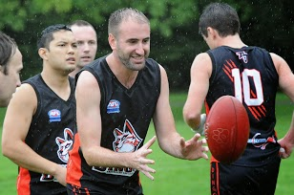
ROUND 12
  Division 2
  12.11-83 3.2-20
  Goals : Tinks 2, JV 2, Tom Evans 2, Ben Kav 2, Lanning, Crossy, Jimmy, Timmy
  Best : Tom Evans

Slide 73
Round 12 Votes
~Division 2~
•BALLOT•
•RUNNING TOTAL•
Best & Fairest
Steve Gordon 7
Alvin Ranchhod 7
Steve Lanning 6
Tom Evans 3
Ben Kavenagh 3
Ben King 3
Gary Conlon 2
Drew Bremner 2

Slide 74
Round 12 Votes
~Division 2~
•BALLOT•
•RUNNING TOTAL•
Tom Evans 3
James Sheehan 2
Drew Bremner 1
Best & Fairest
Steve Gordon 7
Alvin Ranchhod 7
Tom Evans 6
Steve Lanning 6
James Sheehan 4
Ben Kavenagh 3
Ben King 3
Drew Bremner 3

Slide 75
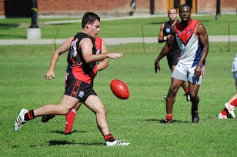
ROUND 12
  Division 1
  7.3-45 15.9-99
  Goals : Camilo 3, Jimmy, Butch, Danny Mac, Rainer
  Best : Camilo

Slide 76
Round 12 Votes
•BALLOTS•
•RUNNING TOTAL•
Best & Fairest
Wade Edwards 102
Craig Stewart 78
Malcolm Brady 56
Shaun McKay 55
Rainer Haycraft 46
Best & Fairest
James Duggan 69
Yoni Moussadji 52
D’Arcy Hill 40
Dave Wells 37
Rookie of the Year
D’Arcy Hill 40
Max Parish 33
Camilo Serpa 24

Slide 77
Round 12 Votes
•BALLOTS•
•RUNNING TOTAL•
Camilo Serpa 7
Shaun McKay 6
Bobby Clarke 5
Yoni Moussadji 4
Danny McIlravey 3
Best & Fairest
Wade Edwards 102
Craig Stewart 78
Shaun McKay 61
Malcolm Brady 56
Rainer Haycraft 46
Best & Fairest
James Duggan 69
Yoni Moussadji 56
D’Arcy Hill 40
Dave Wells 37
Rookie of the Year
D’Arcy Hill 40
Max Parish 33
Camilo Serpa 31

Slide 78
Round 12 Votes
•BALLOTS•
•RUNNING TOTAL•
Camilo Serpa 7
Shaun McKay 6
Bobby Clarke 5
Yoni Moussadji 4
Danny McIlravey 3
Shaun McKay 7
Bobby Clarke 6
Dave Wells 5
Anthony O’Brien 4
Yoni Moussadji 3
Best & Fairest
Wade Edwards 102
Craig Stewart 78
Shaun McKay 68
Malcolm Brady 56
Rainer Haycraft 46
Best & Fairest
James Duggan 69
Yoni Moussadji 59
Dave Wells 42
D’Arcy Hill 40
Rookie of the Year
D’Arcy Hill 40
Max Parish 33
Camilo Serpa 31

Slide 79
Round 12 Votes
•BALLOTS•
•RUNNING TOTAL•
Camilo Serpa 7
Shaun McKay 6
Bobby Clarke 5
Yoni Moussadji 4
Danny McIlravey 3
Shaun McKay 7
Bobby Clarke 6
Dave Wells 5
Anthony O’Brien 4
Yoni Moussadji 3
Bobby Clarke 7
Shaun McKay 6
Camilo Serpa 5
Craig Stewart 4
Matthew Pollett 3
Best & Fairest
Wade Edwards 102
Craig Stewart 82
Shaun McKay 74
Malcolm Brady 56
Rainer Haycraft 46
Best & Fairest
James Duggan 69
Yoni Moussadji 59
Dave Wells 42
D’Arcy Hill 40
Rookie of the Year
D’Arcy Hill 40
Camilo Serpa 36
Max Parish 33

Slide 80
FINAL STANDINGS
DIVISION 1
Wade Edwards 102
Craig Stewart 82
Shaun McKay 74
James Duggan 69
Yoni Moussadji 59
Malcolm Brady 56
Dave Wells 42
D’Arcy Hill 40
Camilo Serpa 36
Max Parish 33
DIVISION 2
Steve Gordon 7
Alvin Ranchhod 7
Tom Evans 6
Steve Lanning 6
James Sheehan 4
Ben Kavenagh 3
Ben King 3
Drew Bremner 3

Slide 81

2013 toronto dingos award winners
Best & Fairest (Div 2)
    Alvin Ranchhod & Steve Gordon: 7 Votes
Australian & Dingos Best and Fairest (Div 1)
    Wade Edwards (102 Votes)
Canadian Best and Fairest (Div 1)
    James Duggan (69 Votes)
Australian Runner-Up (Div 1)
    Craig Stewart (82 Votes)
Canadian Runner-Up (Div 1)
    Yoni Moussadji (59 Votes)
Rookie Award
    D’Arcy Hill (40 Votes)

